Slide 1
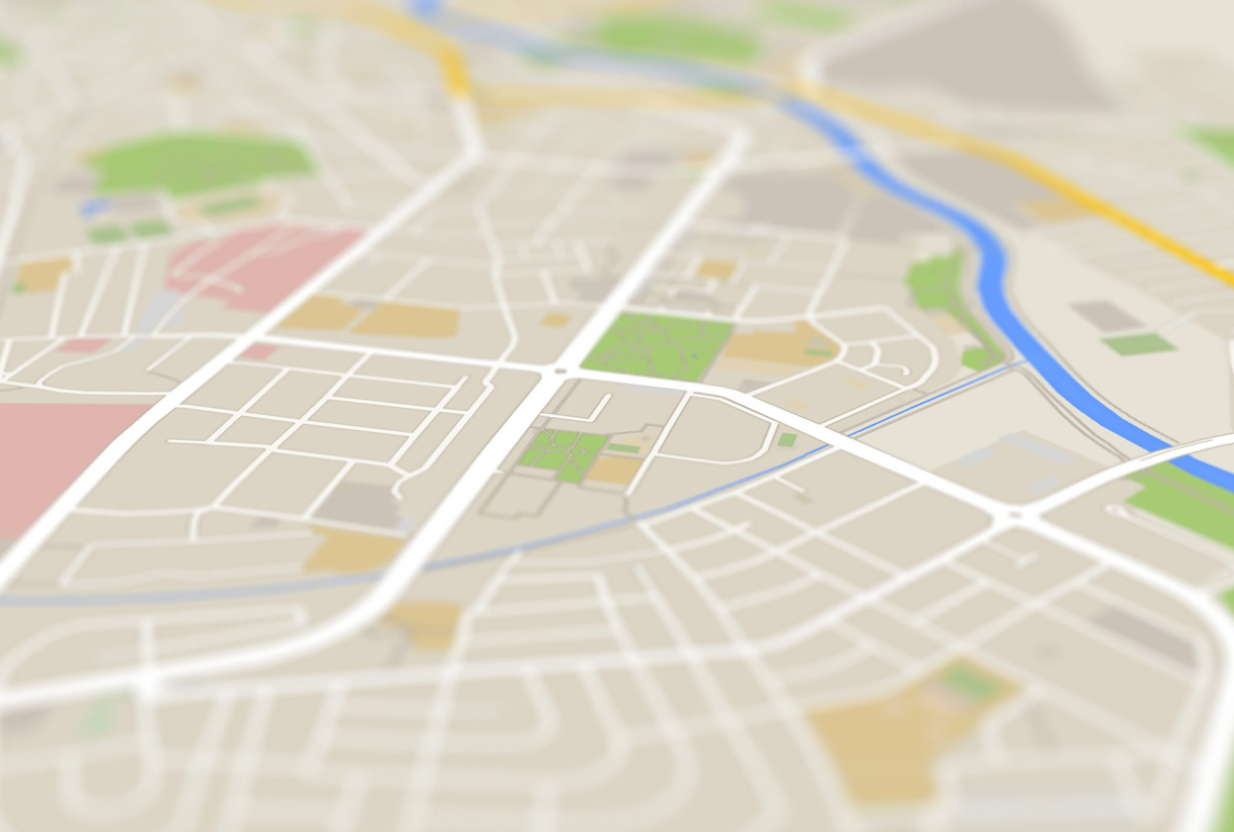
Dijkstra’s Algorithm in the Real World (SL Building)
Max Comer & David Nguyen

Slide 2
Project Summary
What did we do?
Created a web application for indoor navigation of the SL Building
Why did we do it?
To expand on class concepts by using a covered programming language in implementation
To create a practical application that has real world use
How did we do it?
Written in JavaScript
Applying graph theory

Slide 3

Learning More About JavaScript

Slide 4
JavaScript Classes
Syntactic Sugar
Class Syntax/Structure
Not what they look like...
Object Composition

Slide 5
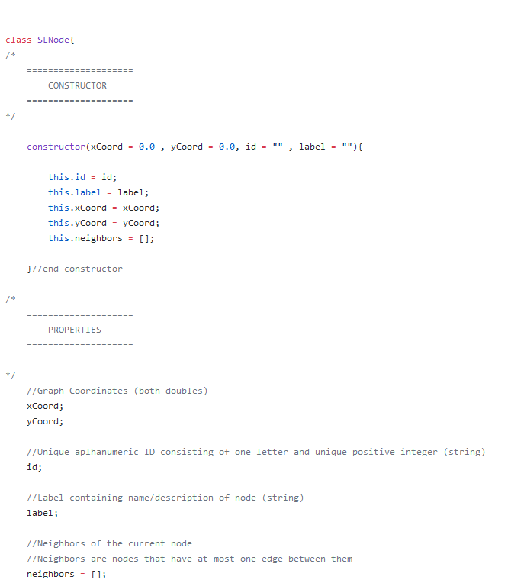
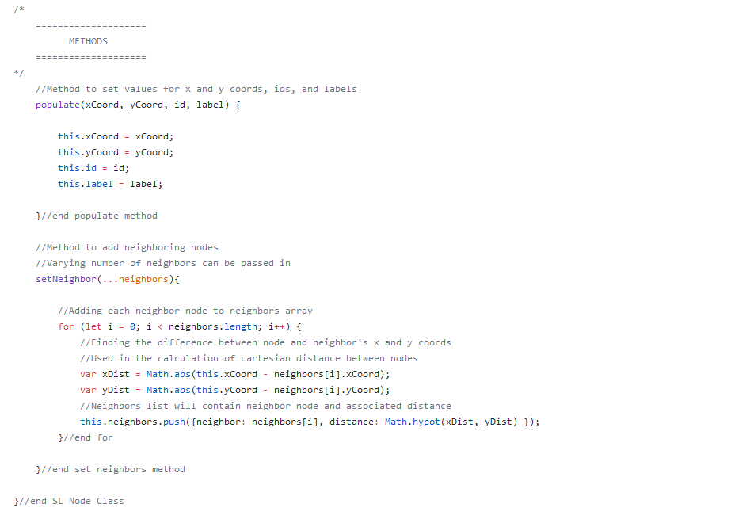
SLNode Class

Slide 6

JavaScript Outside of the Web
“Vanilla” JavaScript
Node.js Environment
Developing with Node.js
Local File I/O

Slide 7
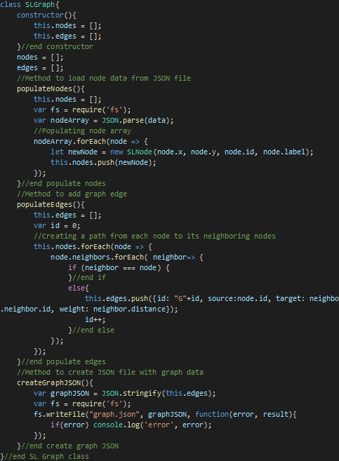
Implementing Data Structures in JavaScript
JavaScript’s writability and expressiveness allow for relative ease of implementing data structures
No pointer manipulation

Slide 8
Dijkstra’s Explanation for the Uninitiated

Slide 9
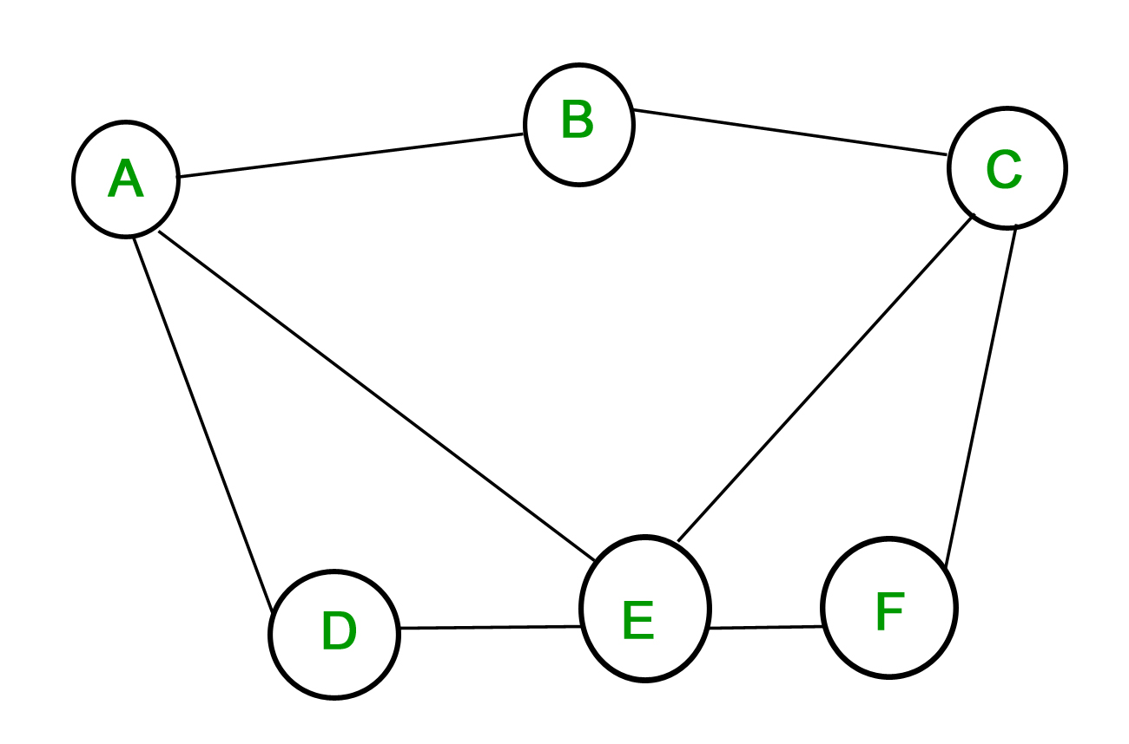
What’s a graph?
1
2
Node
A graph is a collection of nodes and edges.
Essentially a “map”.
Nodes: destinations on a map
Edges/Vertices: paths to said destination
Weight: length of a given path
3
4
Edge
69
5
2
1

Slide 10
How Dijkstra’s algorithm works:
1
2
Travel to the “nearest” non visited node.
Check weights of all neighboring node edges.
Overwrite record with lower weights to a given node.
Store associated path.
Push node to a list of “visited” nodes.
Repeat Steps 1 - 4 until all nodes have been visited.
Return shortest paths from selected node.
Node | Shortest Distance | Path
A
B
C
D
E
F
3
4
0
-
69
5
1
A → B
3
A → B → C
2
1
69
A → D
Visited:
A
B
C
E
F
D
5
A → E → D
3
A → E
Done!
8
A → B → C → F
4
A → E → F

Slide 11
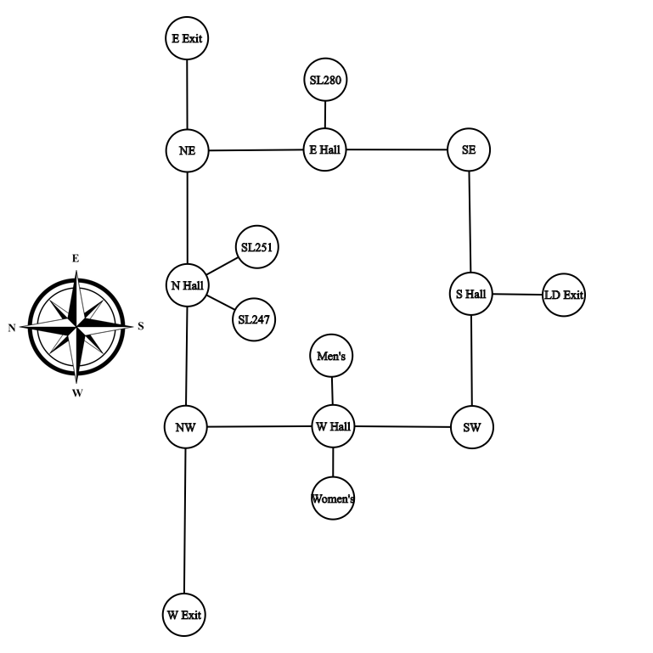
Simplified recreation of the SL Building 2nd Floor layout in a graph format.

Slide 12
Applying Dijkstra’s to SL
Given user-selected starting and end nodes, find the shortest path between said nodes and produce visual output on graph.

Slide 13

Conclusion

Slide 14
Challenges and Difficulties
Gathering data
Making the map
Keeping track of shortest paths
Creating the map interface

